Slide 1
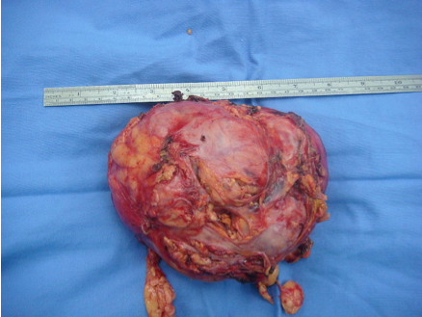
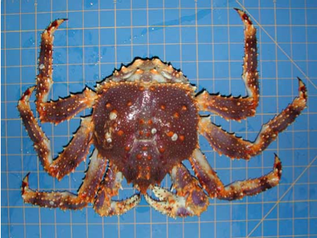
Cancer
Lesson 1.2
How has our understanding of cancer changed over time?
Hippocrates coined the term cancer
from the Greek word ‘Karkinos’ meaning crab

Slide 2
Do Now
Hippocrates believed that cancer was a “death sentence” and caused by accumulation of “bad fluids.”
How much has our current view of cancer changed since then?

Slide 3
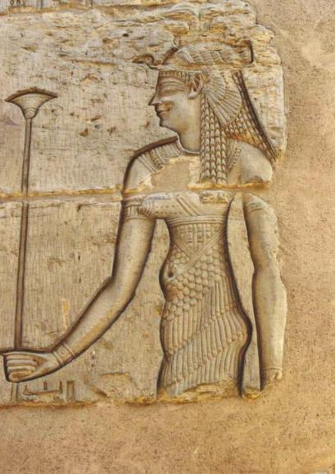
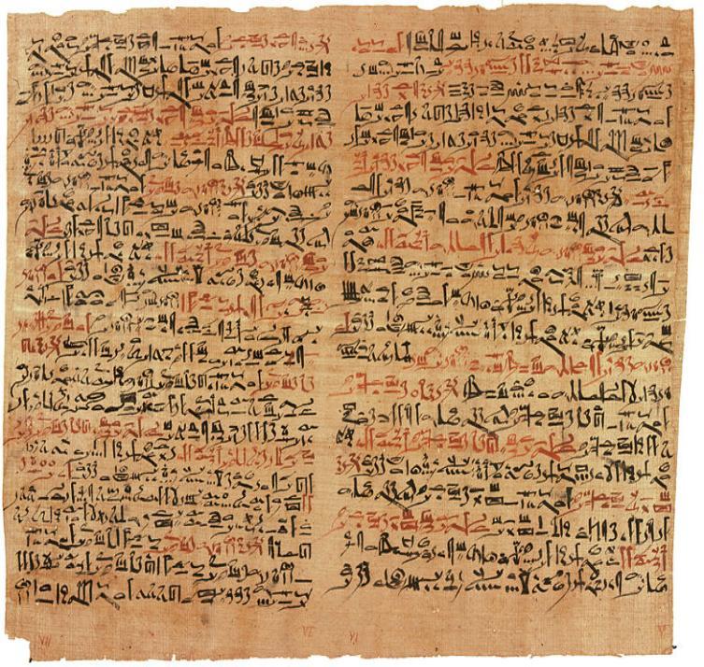
The oldest description of cancer is on an Egyptian papyrus
“There is no cure”
This papyrus is part of a book on trauma surgery written in 3000 BC.

Slide 4
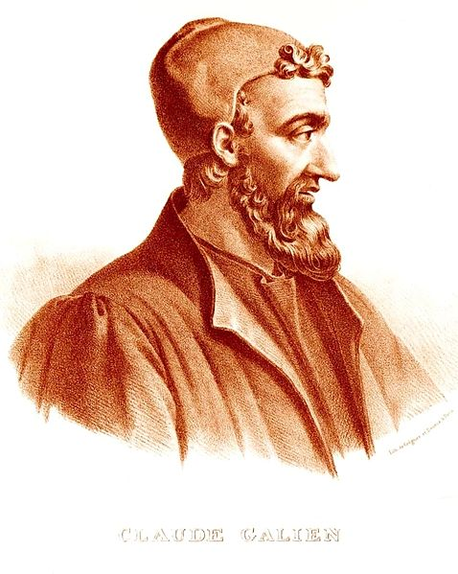
Bad fluids theory
Galen thought that
the body is composed of 4 humors:
Red
Phlegm
Yellow bile
Black bile
Cancer occurs when black
bile accumulates.

Slide 5
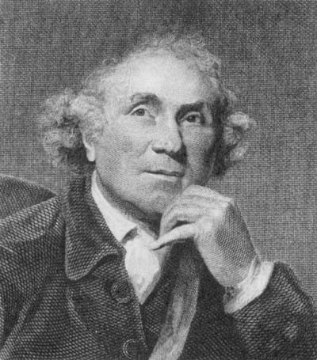
Solid tumor theory
John Hunter (16th -17th century) pathologist
Observed that solid tumors in one organ seemed to spread to others
The first description of metastasis
John Hunter

Slide 6
Activity:
Divide into six groups to research the impacts the
following scientists have had on our understanding of cancer : 1. Hippocrates
2. Galen 3. Andreas Vesalius 4. Antonie Van Leeuwenhoek 5. Rudolf Virchow 6. Stephen Paget

Slide 7
Make sure to address the following questions:
When in history did they live?
What was their most notable finding relevant to
cancer?
How did this discovery impact what we understand about cancer?

Slide 8
Cancer history timeline
500BC
0AD
500AD
1000AD
1500AD
2000AD
Vesalius
Hippocrates
Galen
Virchow
Van Leeuwenhoek
Paget

Slide 9
Their most notable finding relevant to cancer
Hippocrates
Galen
Vesalius
Van Leeuwenhoek
Virchow
Paget
First characterized cancer
Classified four humors
Dissected the human body
Visualized cells
Cells come from other cells
Secondary tumors prefer certain organs

Slide 10
What was its impact?
Hippocrates
Galen
Vesalius
Van Leeuwenhoek
Virchow
Paget
Cancer is untreatable
Black bile accumulation
Cancer is solid tumors
Tumors are made of cells
Tumor cells divide rapidly
Tumor spreading important for disease

Slide 11
Wrap up
500BC
0AD
500AD
1000AD
1500AD
2000AD
Hippocrates
Galen
Vesalius
Paget
Virchow
Van Leeuwenhoek
If you had cancer in: 1000BC, 0AD, 1500AD, 2000AD
How would you have been treated?
What factors would influence the treatment’s success?

Slide 12
Wrap up:
Revisiting Hippocrates
Can cancer be described as a disease of “bad fluids?”

Slide 13
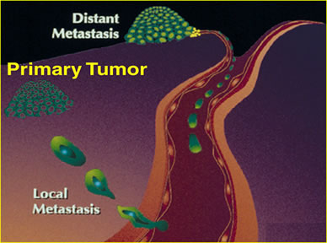
Metastasis = Bad Fluids?
Cancer cells in the blood stream can form secondary tumors by entering and growing in another organ.

Slide 14
Is Cancer a Death Sentence?
Cancer | 1975 | 2005
Breast | 75.2 % | 90.6 %
Colorectal | 48.6 % | 65.9 %
Leukemia | 33.1 % | 60.8 %
Lung | 11.4% | 17.5 %
Skin (Melanoma) | 81.8 % | 92.8 %
Pancreas | 3 % | 7.3 %
Prostate | 66 % | 99.6 %
Data shows percent of people diagnosed with a cancer that are alive 5 years later

Slide 15
What affects our ability to survive cancer?
Early diagnosis
Treatability
Prevention
Notes:
Cancers sensitivity to treatment varies depending on organ and even cell of origin.
Since 1990, we have drugs that can specifically kill or prevent certain types of cancer.
Petrochemicals (plastics, burning oil/coal) are known carcinogens and are becoming more common in society.
Cigarettes were common post WWII and are slowly being phased out.
Testicular cancer easy to treat surgically if diagnosed and treated early.
Pancreatic cancer difficult to diagnose early.
Breast cancer is more easy to diagnose, but some types of cancer are insensitive to treatment and very aggressive.
Increase of smoking led to more lung cancer and tobacco-related cancers (esophageal, mouth, nasopharyngeal tumors). Decreased smoking has led to reduction in these types of cancers.

Slide 16
Homework
Read lesson 1.3 in the workbook and answer the questions on it.

